Slide 1
CREATE TIME ATTRIBUTE VIEW.
Milind Parab

Slide 2
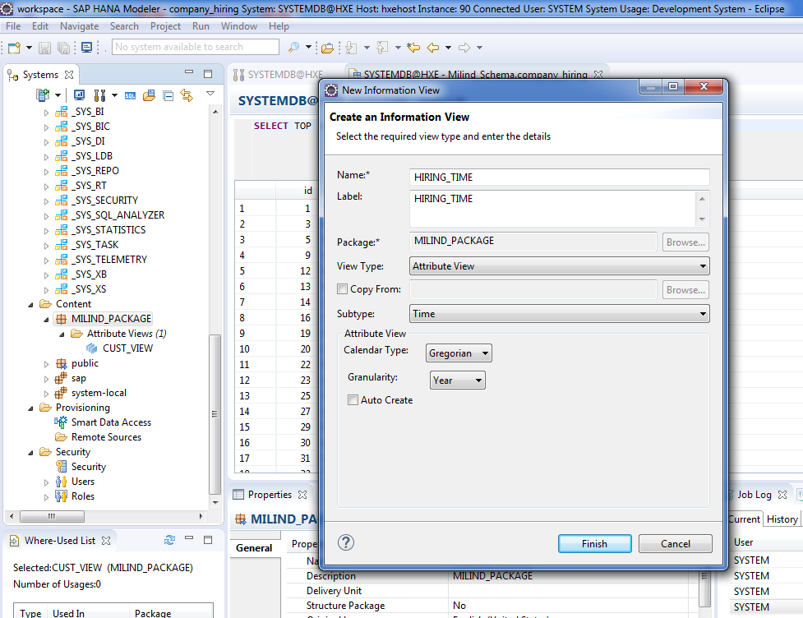
Create Time Attribute View.

Slide 3
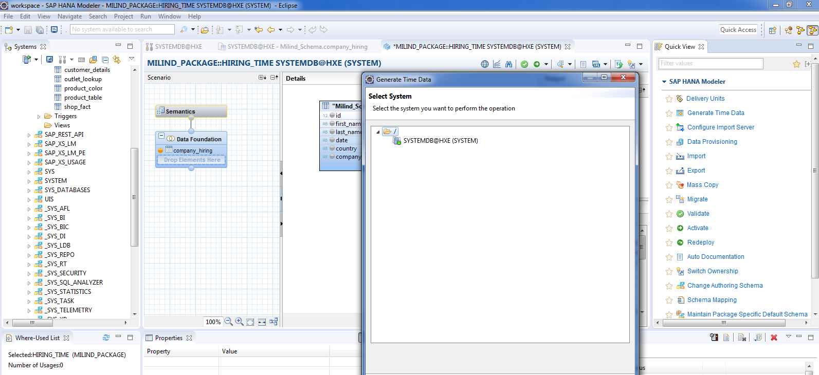
Click on generate Time View.

Slide 4
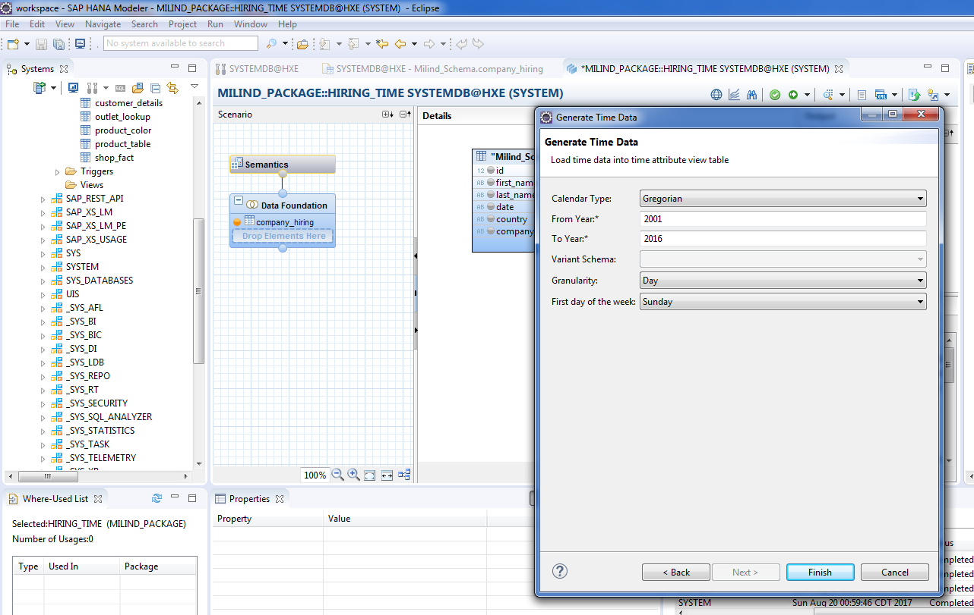
Click on finish.

Slide 5
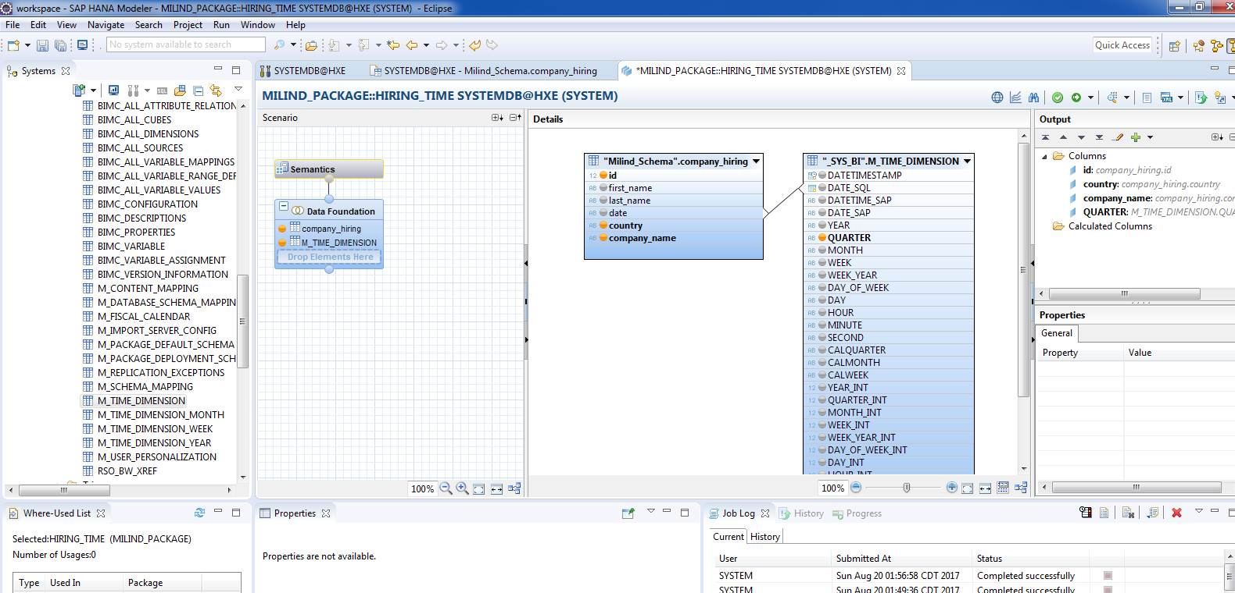
Include Company hiring and M_TIME_DIMENSION.

Slide 6
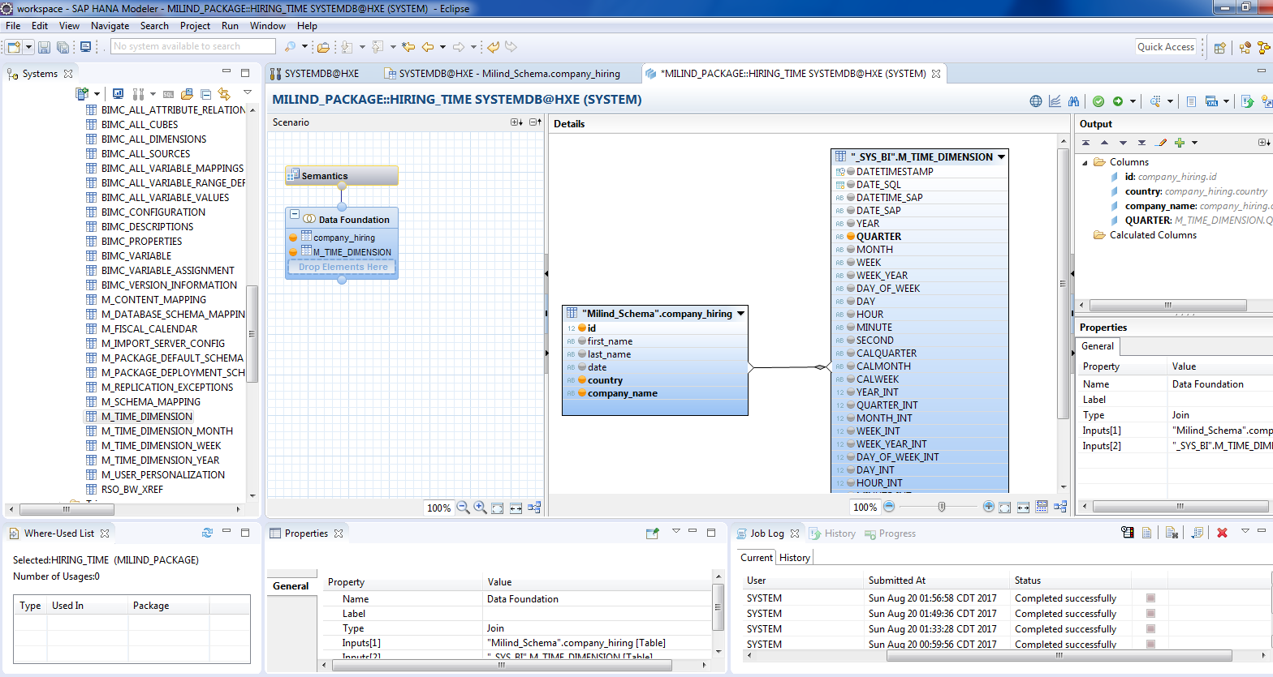
Cont.

Slide 7
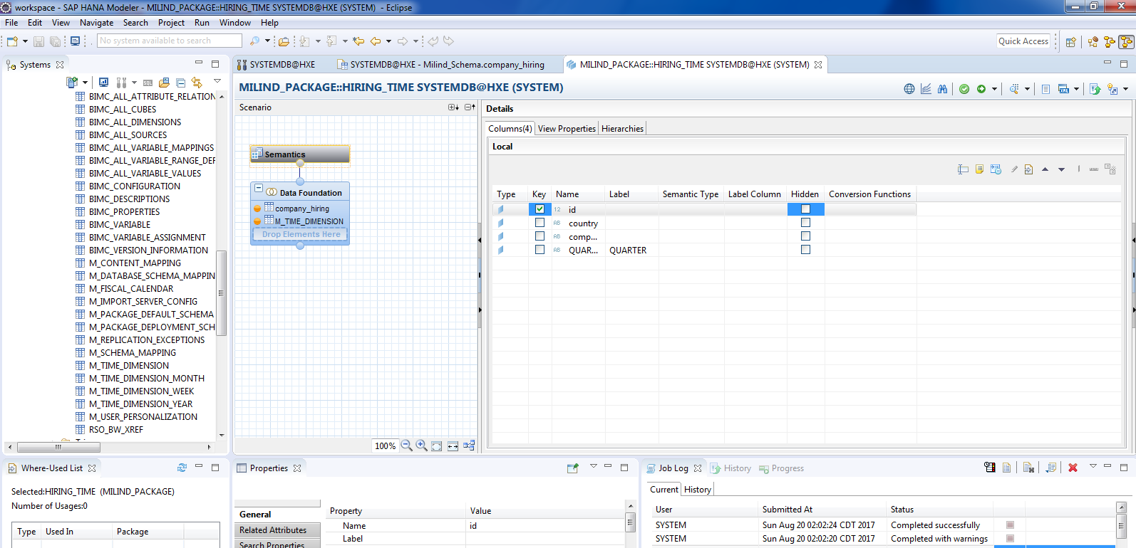
Go to semantic, select key attribute and activate.

